Slide 1
Recursion
“In order to understand recursion, one must first understand recursion”
Abu Ibrahim Iqra
BRAC UNIVERSITY

Slide 2
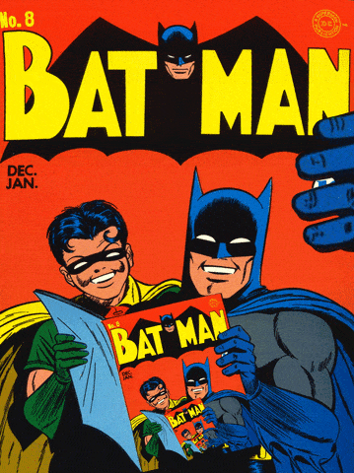
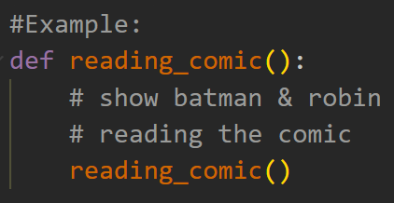
What is Recursion?
In the field of computer science, Recursion is defined as a process or function calling upon itself during its own execution.

Slide 3
Components Recursive Function
Base Case:
One or more conditions based on which the function will stop the recursive call.
Recursive Case:
The function calling itself within its definition.

Slide 4
Solving problems using Recursion
[Factorial]
5! = 5*4*3*2*1
4! = 4*3*2*1
3! = 3*2*1
2! = 2*1
1! = 1
0! = 1
5! = 5*4!
4! = 4*3!
3! = 3*2!
2! = 2*1!
1! = 1
0! = 1
Assuming the function is defined as factorial(n).
Base Case:
n=0 or n=1
Recursive case:
n*factorial(n-1)

Slide 5
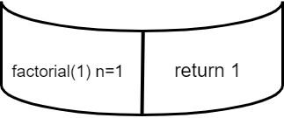
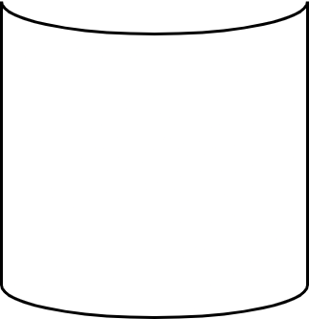
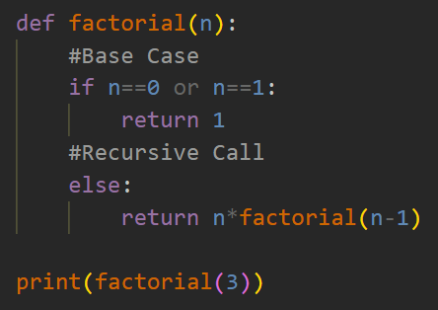
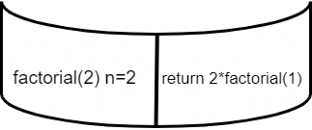
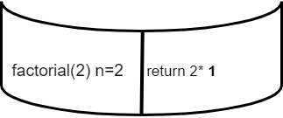
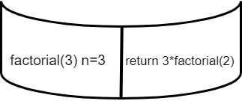
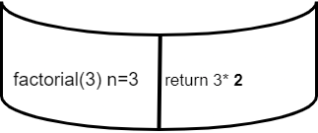
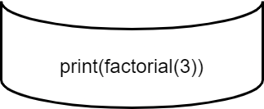
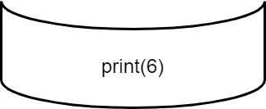
The Call Stack
Output: 6

Slide 6

What happens when wrong
Base Condition?

Slide 7
Thank You

